Slide 1
LRU Page Replacement Algorithm (Hardware) – Solution 1
Least recently used
Maintain a hardware counter C, automatically incremented after each instruction
Each page table entry also has a counter variable
For each memory reference, update the counter for the corresponding page table entry
After a page fault, OS examines all the counters and picks the one with the lowest counter value

Slide 2
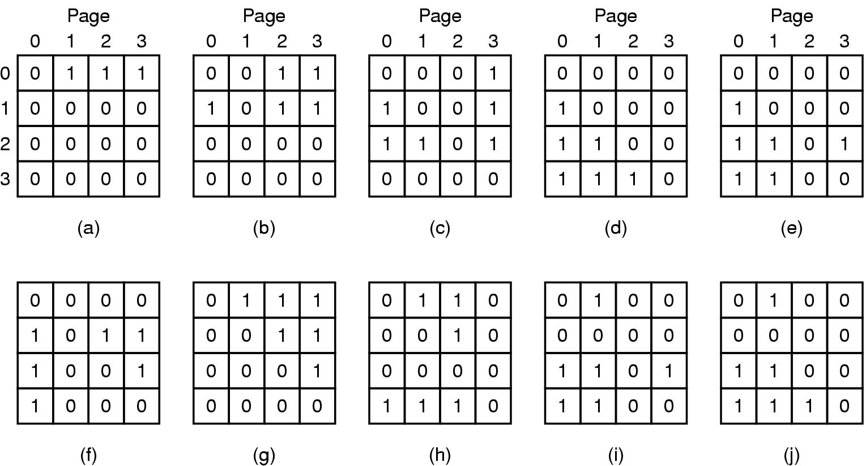
LRU Page Replacement Algorithm (Hardware) – Solution 2
LRU using a matrix when pages are referenced in the order 0, 1, 2, 3, 2, 1, 0, 3, 2, 3.

Slide 3
LRU Page Replacement Algorithm (Hardware) – Solution 2
Hard to implement in hardware ☹
LRU using a matrix when pages are referenced in the order 0, 1, 2, 3, 2, 1, 0, 3, 2, 3.

Slide 4
Simulating LRU in Software

Slide 5
Not Frequently Used (NFU)
Software counter for each page table entry
At each clock interrupt, OS scans all the pages and add the R bit to the counter
At page fault, choose the page with the lowest counter value

Slide 6
Not Frequently Used (NFU)
Software counter for each page table entry
At each clock interrupt, OS scans all the pages and add the R bit to the counter
At page fault, choose the page with the lowest counter value
Never forgets anything ☹

Slide 7
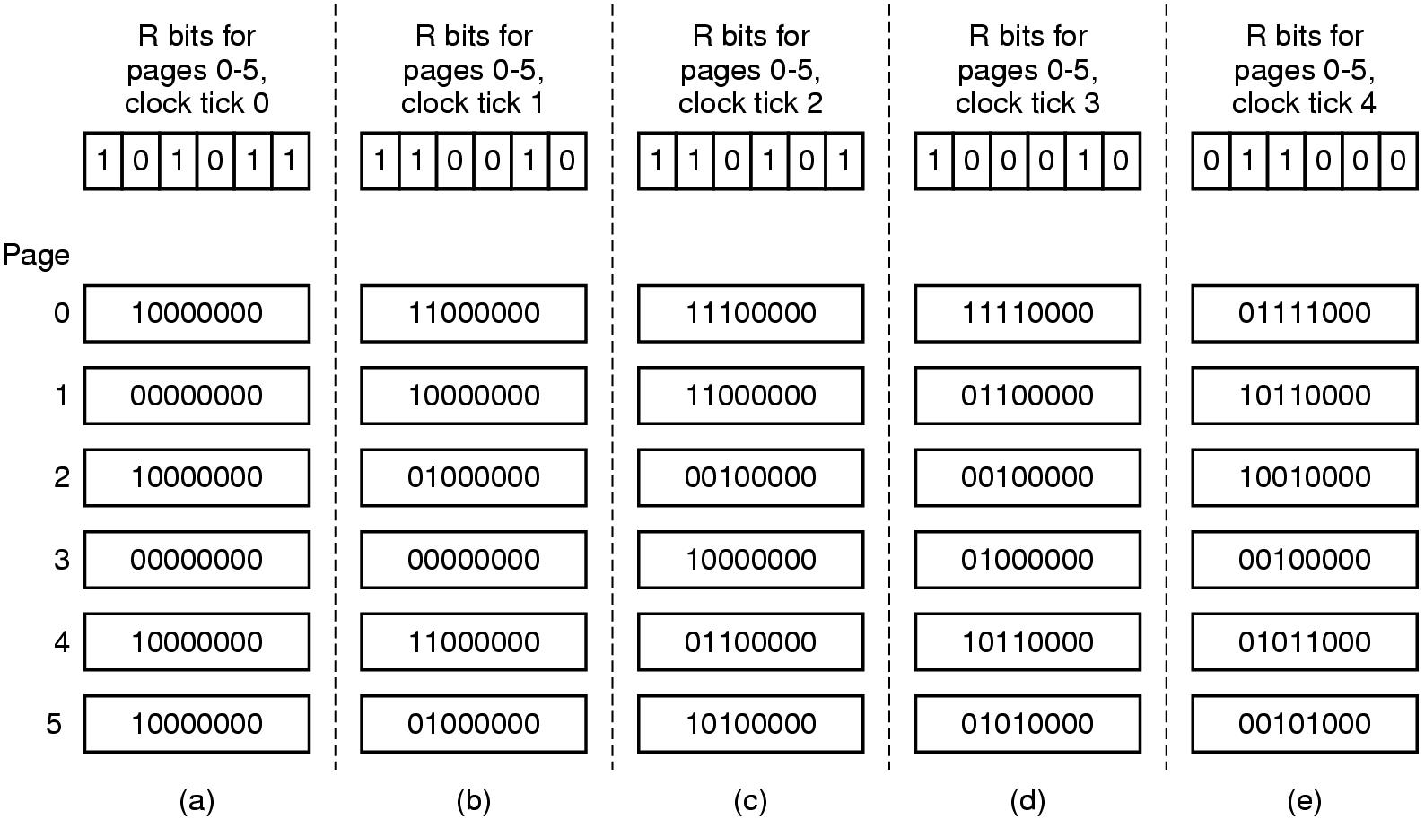
Small Modification to NFU ->
Simulating LRU in Software
The aging algorithm simulates LRU in software. Shown are six pages for five clock ticks. The five clock ticks are represented by (a) to (e).

Slide 8
Simulating LRU in Software
Limitations?
8 bits limits the horizon
Within a single tick, no way of knowing which was referenced earlier
A single tick can be few milliseconds

Slide 9
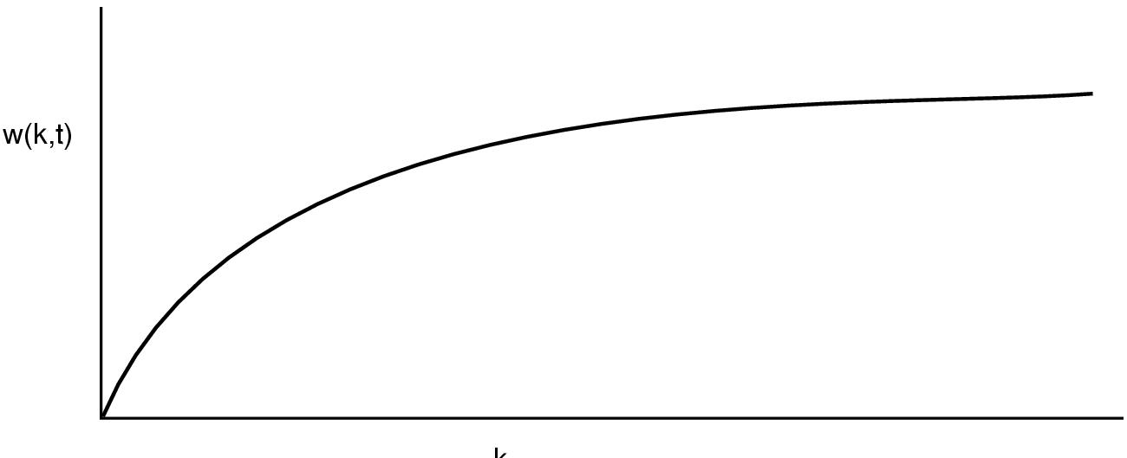
Working Set Page Replacement (1)
Demand Paging: Fetch page if page fault occurs
Thrashing: Page fault every few instructions
Can we exploit locality of reference?
Prepaging?
The working set is the set of pages used by the k most recent memory references. The function w(k, t) is the size of the working set at time t.

Slide 10
The WSClock Page Replacement Algorithm (1)
Need to keep track of working set!
Set of pages referenced in the last k memory references!
Expensive to implement!
Keep track for last t sec

Slide 11
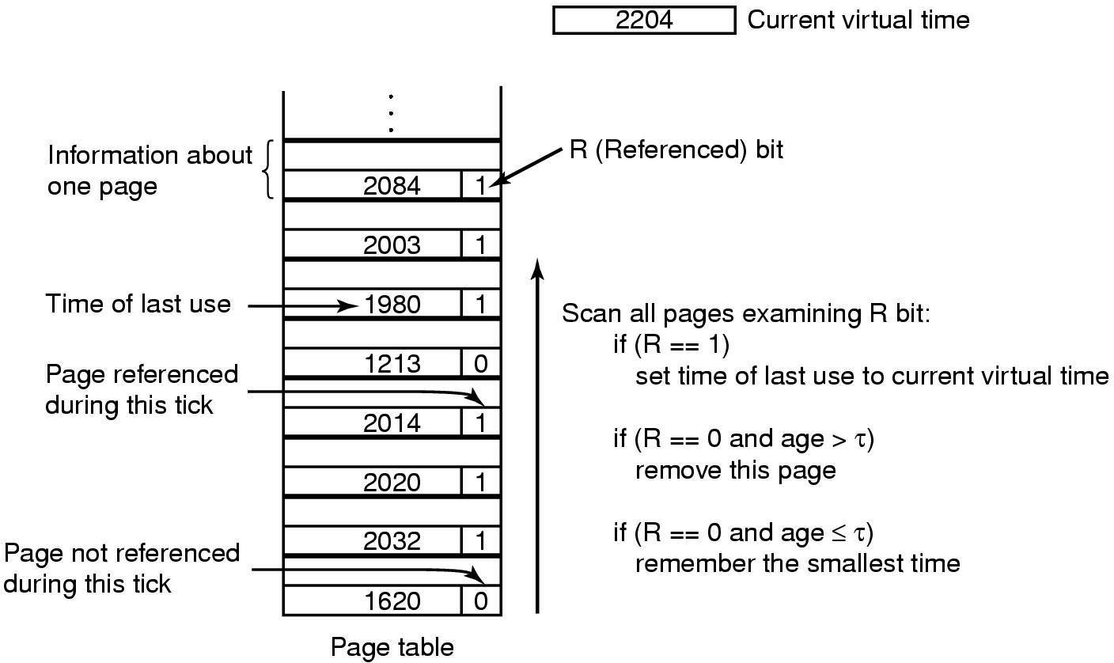
Working Set Page Replacement (2)
The working set algorithm.

Slide 12
Working Set Page Replacement (2)
Need to scan entire table at a page fault!
The working set algorithm.

Slide 13
The WSClock Page Replacement Algorithm (1)
WorkingSet Clock Algorithm
If old page and M=0, claim
If old page and M=1, schedule write to avoid context switch
When the hand comes all the way around to its starting point there are
two cases to consider:
At least one write has been scheduled.
Keep scanning to find a clean page
No writes have been scheduled.
Claim any clean page and use it

Slide 14
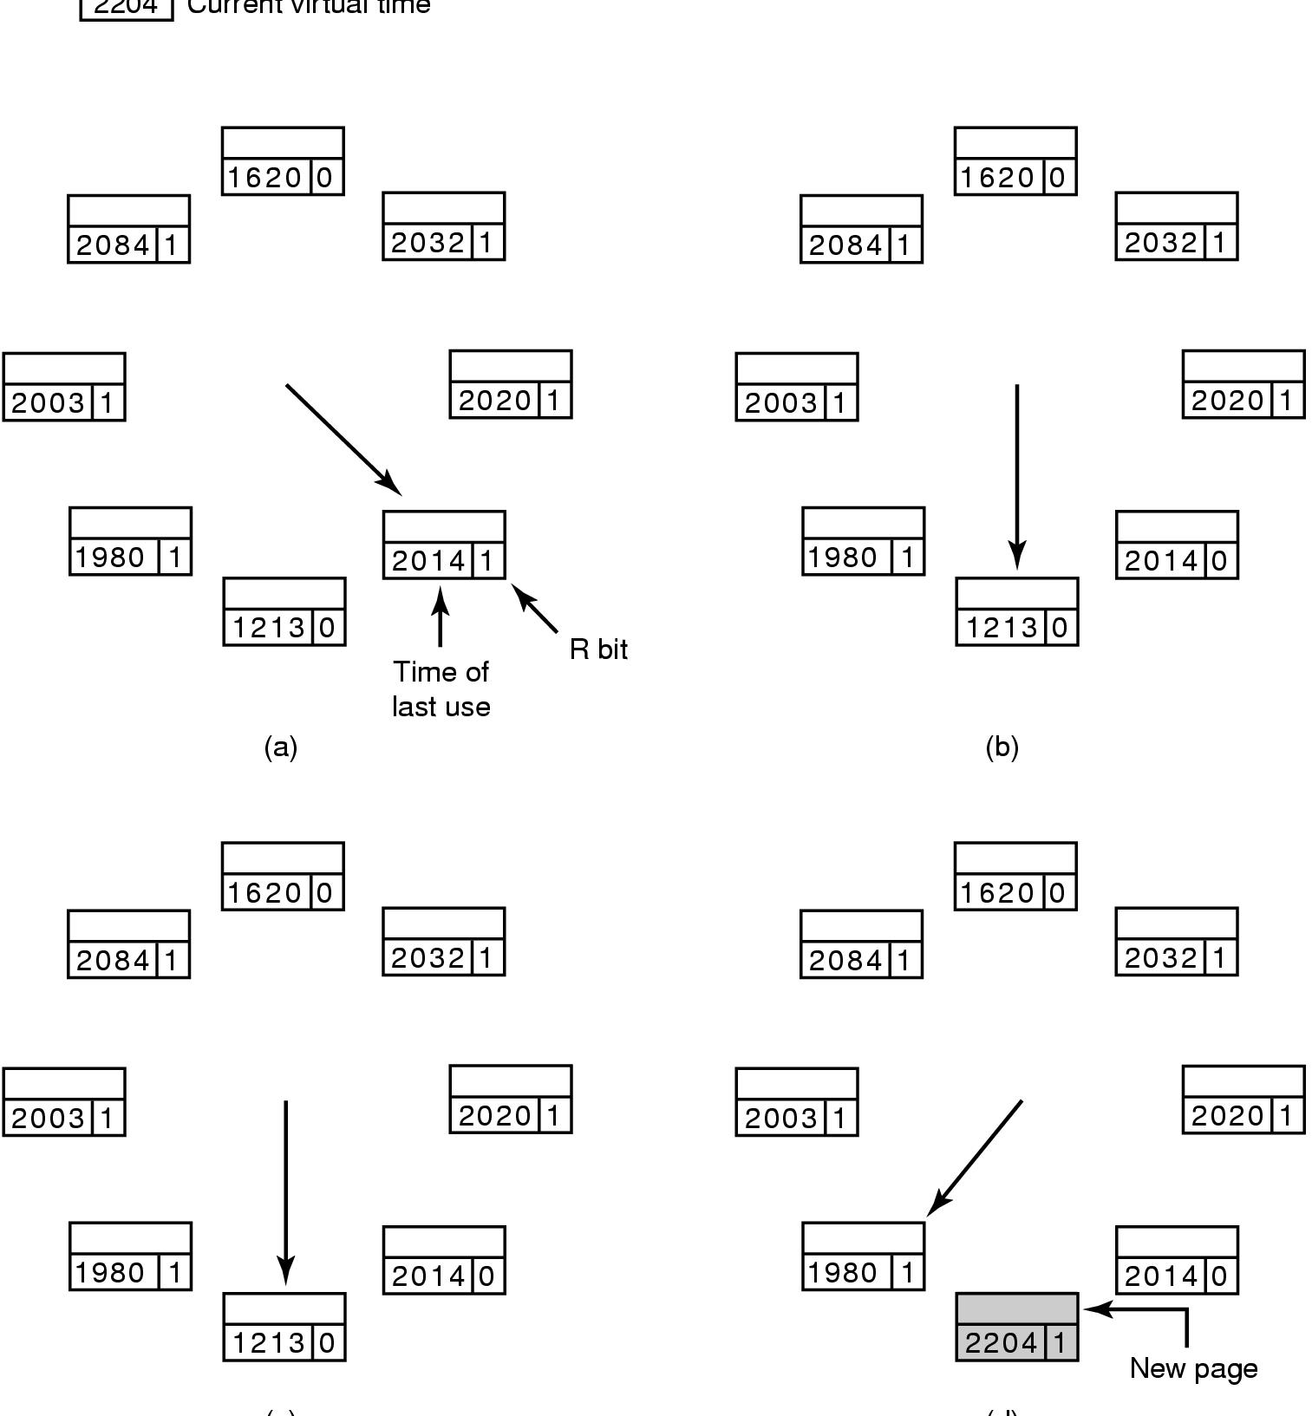
The WSClock Page Replacement Algorithm (2)
2204
Current virtual time
(c)
(d)
Operation of the WSClock algorithm. (a) and (b) give an example of what happens when R = 1.

Slide 15
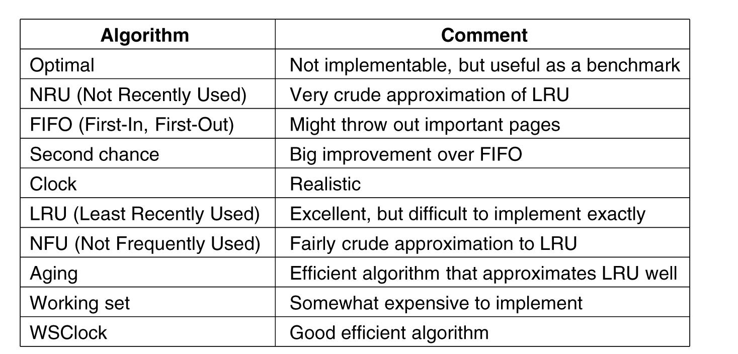
Summary of Page Replacement Algorithms
Page replacement algorithms discussed in the text.

Slide 16
Design Issues for Paging System

Slide 18
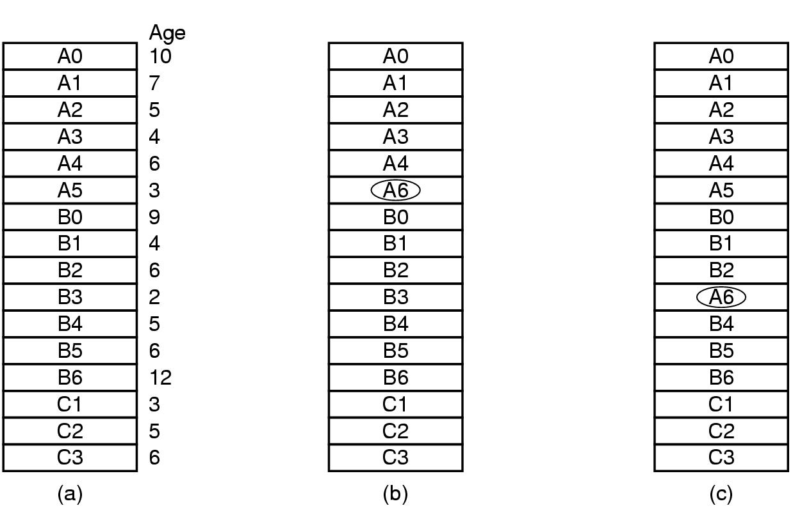
Local versus Global Allocation Policies (1)
Figure 3-23. Local versus global page replacement. (a) Original configuration. (b) Local page replacement. (c) Global page replacement.

Slide 20
Global is better, if working set size can vary over the lifetime of the process.
An algorithm is needed to decide how to allocate pages/process
Can allocate equal share
Can allocate proportional to the process size
Can allocate based on page fault frequency (PPF)

Slide 22
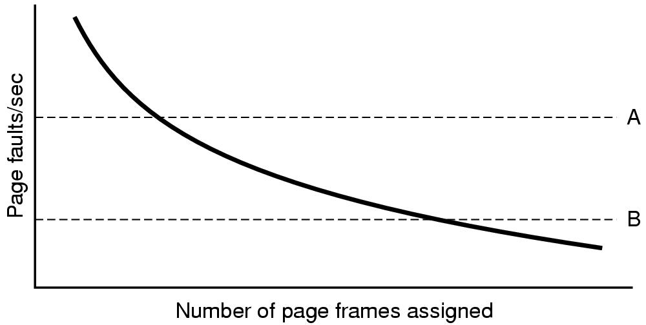
Local versus Global Allocation Policies (2)
Page fault rate as a function of
the number of page frames assigned.
Some algorithm can work with both local and global policy (e.g., LRU, FIFO)
Some algorithms only make sense with Local policy (?)

Slide 23
Load Control
Some process needs more pages, but none needs less !
Solution: Swap out process to disk
Need to consider characteristics of job!
Degree of multiprogramming?

Slide 24
Page Size
On average, half of the last page is empty (wasted)!
Smaller page: less wasted space!
But, large page table, long loading time!
s= avg process size
p = page size
e = page entry size
Overhead= (s/p)*e + p/2
p=sqrt(2se)

Slide 25
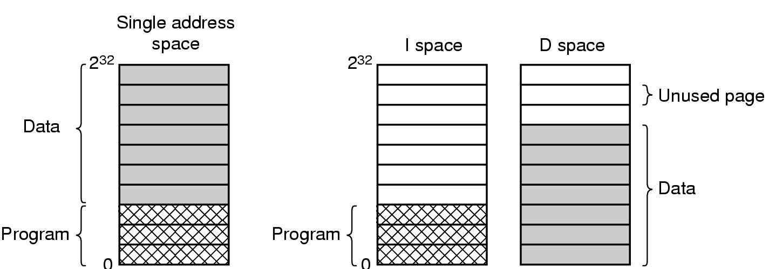
Separate Instruction and Data Spaces
Separate page table
Double the available space
(a) One address space. (b) Separate I and D spaces.

Slide 26
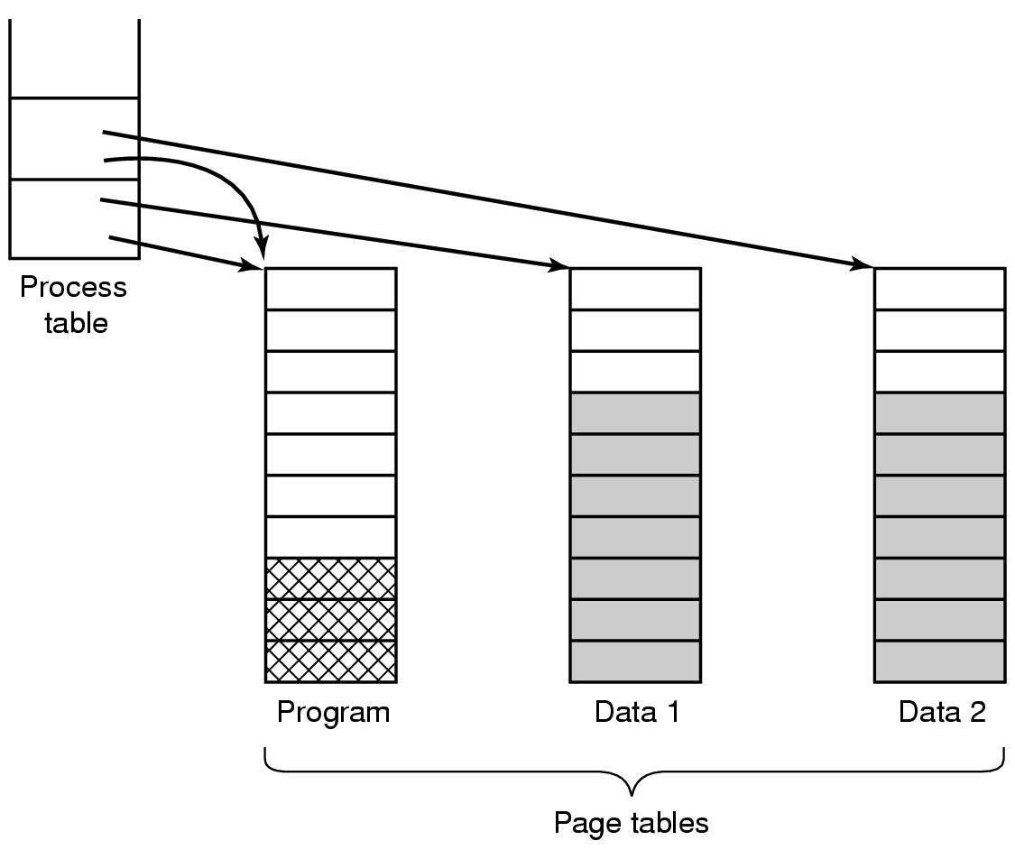
Shared Pages
Copy on write concept
- Initially READ only
- On write, make individual copies and mark READ-WRITE
Two processes sharing the same program sharing its page table.

Slide 27
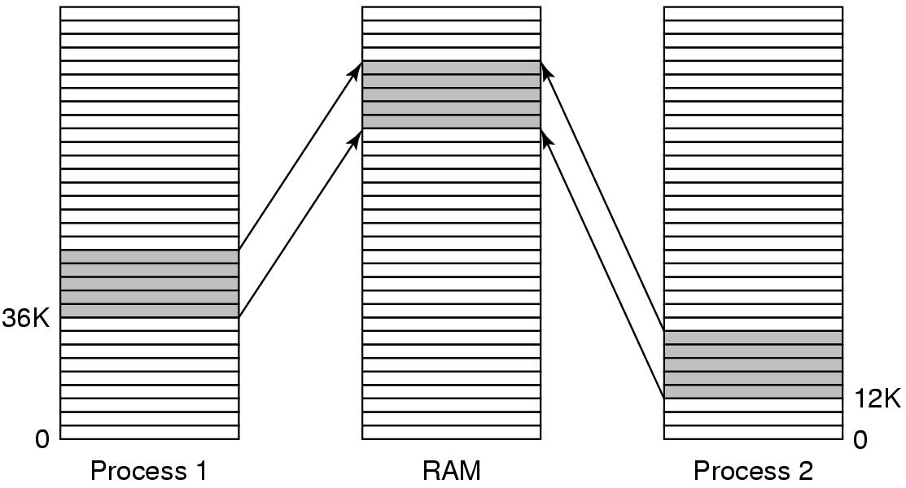
Shared Libraries
Position-independent code
Extra benefit: Easy to fix bug
Example: DLL in Windows
A shared library being used by two processes.

Slide 28
Mapped Files
Used for I/O
Map I/O read/write to address space
Will study later in the course!

Slide 29
Cleaning Policy
Paging Daemon
Periodically checks available memory
If too low, pre-select pages to evict
If dirty, schedule write
If a selected page is required before it is reused, just move it back from available pool of free page frame
Two-handed Clock:
First hand used by the cleaning daemon. Second hand is used by the page replacement algorithm

Slide 30
Implementation Issues

Slide 31
Page Fault Handling (1)
The hardware traps to the kernel, saving the program counter on the stack.
An assembly code routine is started to save the general registers and other volatile information.
The operating system discovers that a page fault has occurred, and tries to discover which virtual page is needed.
Once the virtual address that caused the fault is known, the system checks to see if this address is valid and the protection consistent with the access

Slide 32
Page Fault Handling (2)
If the page frame selected is dirty, the page is scheduled for transfer to the disk, and a context switch takes place.
When page frame is clean, operating system looks up the disk address where the needed page is, schedules a disk operation to bring it in.
When disk interrupt indicates page has arrived, page tables updated to reflect position, frame marked as being in normal state.

Slide 33
Page Fault Handling (3)
Faulting instruction backed up to state it had when it began and program counter reset to point to that instruction.
Faulting process scheduled, operating system returns to the (assembly language) routine that called it.
This routine reloads registers and other state information and returns to user space to continue execution, as if no fault had occurred.

Slide 34
The Issue of Instruction Backup?
From what address to restart the execution?
Locking Pages in Memory?
I/O and page replacement algorithm can interfere
Pinning: locking a page in memory

Slide 35
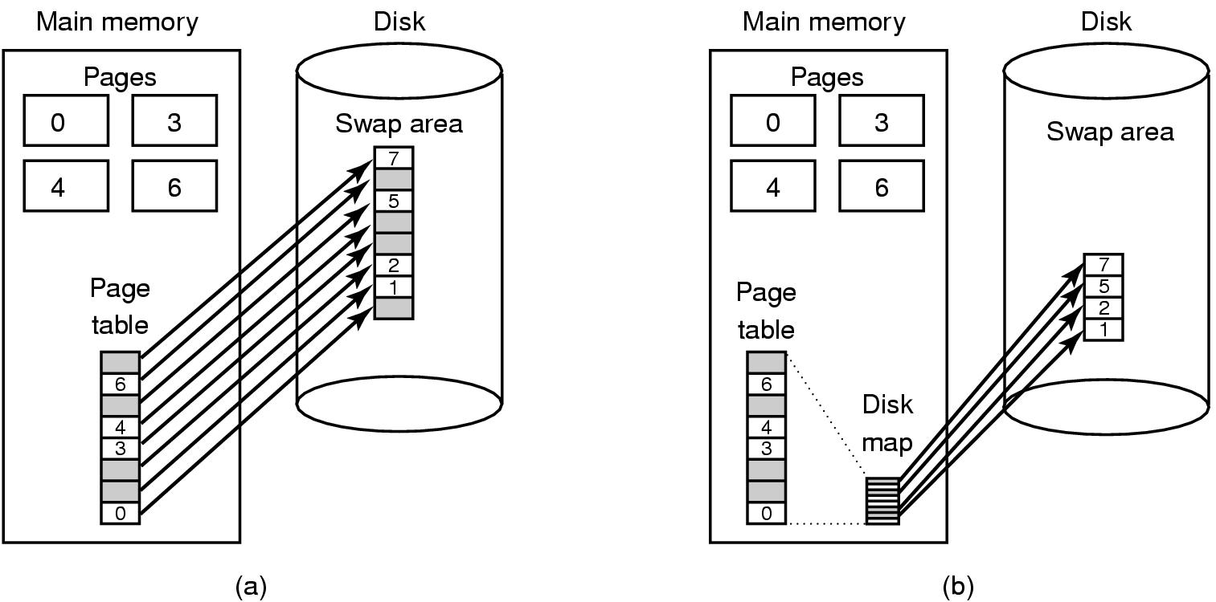
Backing Store
Paging to a static swap area.
Backing up pages dynamically

Slide 36
Segmentation (1)
A compiler has many tables that are built up as compilation proceeds, possibly including:
The source text being saved for the printed listing (on batch systems).
The symbol table – the names and attributes of variables.
The table containing integer, floating-point constants used.
The parse tree, the syntactic analysis of the program.
The stack used for procedure calls within the compiler.

Slide 37
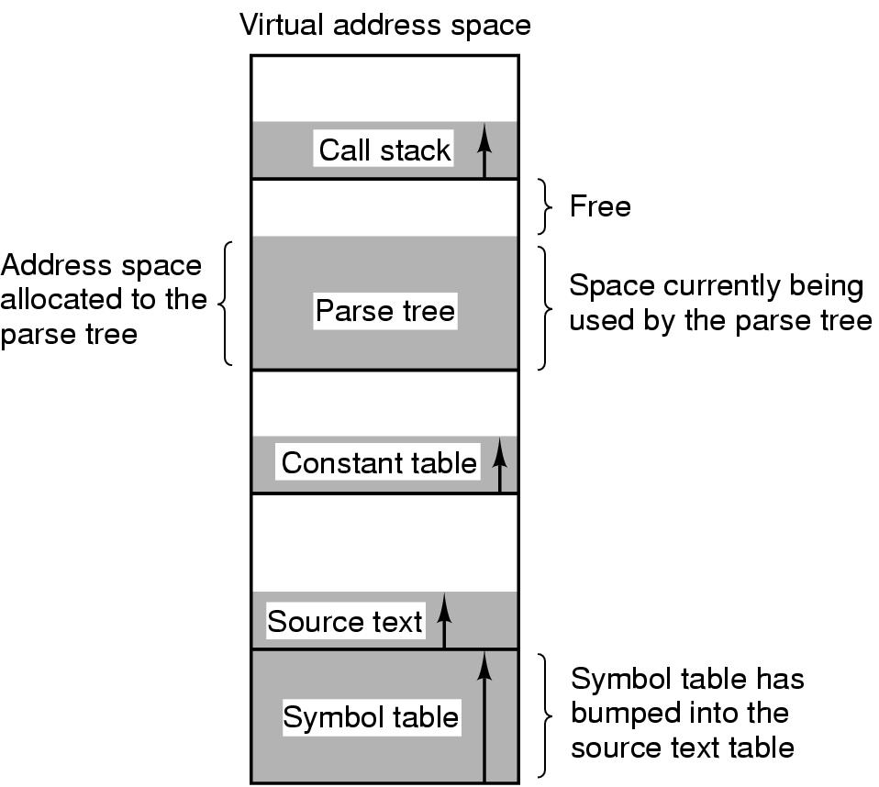
Segmentation (2)
In a one-dimensional address space with growing tables, one table may bump into another.

Slide 38
Segmentation (3)
A segmented memory allows each table to grow or shrink independently of the other tables.

Slide 40
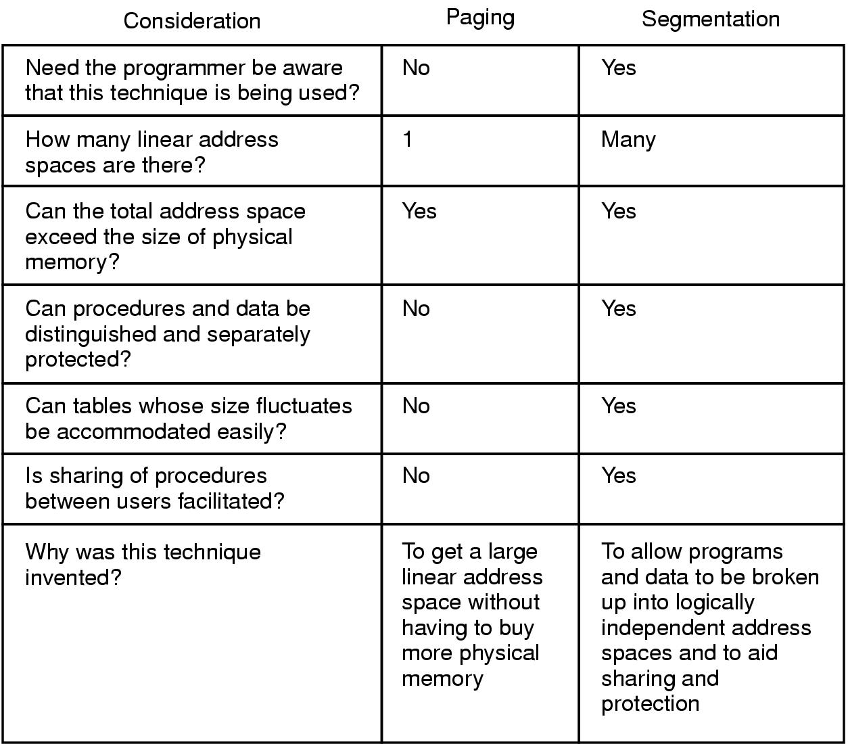
Implementation of Pure Segmentation
Comparison of paging and segmentation.

Slide 41
Segmentation
(a)-(d) Development of checkerboarding. (e) Removal of the checkerboarding by compaction.

Slide 42
Segmentation with Paging: MULTICS

Slide 43
Segmentation with Paging: MULTICS (2)
The MULTICS virtual memory. (a) The descriptor segment points to the page tables.

Slide 44
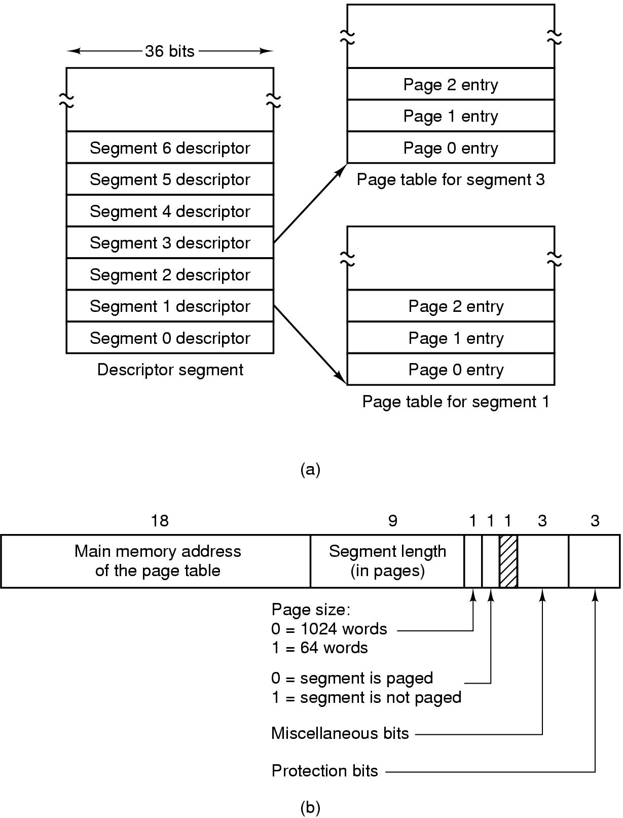
Segmentation with Paging: MULTICS (5)
Virtual memory of up to 2^18 segments
Each segment up to 65,536 words long (2^16)
Each word 36 bit
Each MULTCIS program has –
One segment table, one descriptor/segment
Segment table itself is paged
Descriptor contains 18 bit pointer to its page table
Need another table to save the addresses of the segments
in the secondary memory (e.g., disk), which is used by
the segment fault handler
Page size 1024 words
Address contained two parts – the segment + the address
within the segment
The address within the segment has two parts – page number +
word within the page
The MULTICS virtual memory.
(b) A segment descriptor. The numbers are the field lengths.
A 34-bit MULTICS virtual address.

Slide 45
Segmentation with Paging: MULTICS (6)
When a memory reference occurs, the following algorithm is carried out:
The descriptor base register used to locate the descriptor segment’s page table
The segment number used to find segment descriptor.
Check is made to see if the segment’s page table is in memory.
If not, segment fault occurs.
If there is a protection violation, a fault (trap) occurs.
Page table entry for the requested virtual page examined.
If the page itself is not in memory, a page fault is triggered.
If it is in memory, the main memory address of the start of the page is extracted from the page table entry
The offset is added to the page origin to give the main memory address where the word is located.
The read or store finally takes place.

Slide 47
Segmentation with Paging: MULTICS (9)
Conversion of a two-part MULTICS address into a main memory address.

Slide 48
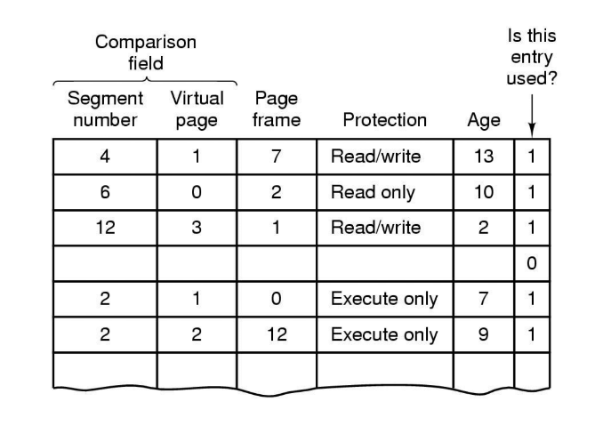
A simplified version of the MULTICS TLB.
Addresses of 16 most recent referenced pages kept in the TLB

Slide 50
Segmentation with Paging: The Pentium

Slide 51
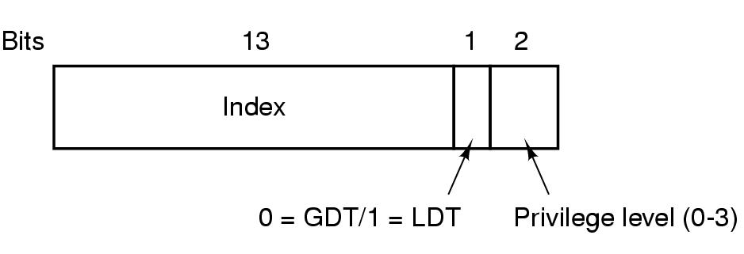
Segmentation with Paging: The Pentium
Multics – 256K segments, each up to 64K 36-bit words
Intel x86 – 16K segments, each up to 1 billion 32-bit words
X86-64 – segmentation is considered obsolete, except in legacy mode
A Pentium selector.
- Each program has its own LDT
Only one GDT – for systems/OS
LDT/GDT can hold upto 8K segment descriptors (2^13)
Descriptor 0 is forbidden
Selector 72 => 0000 0000 0100 1000 => Entry 9 in GDT,
which is located at address GDT+72

Slide 52
Segmentation with Paging: The Pentium
Pentium code segment descriptor. Data segments differ slightly.

Slide 53
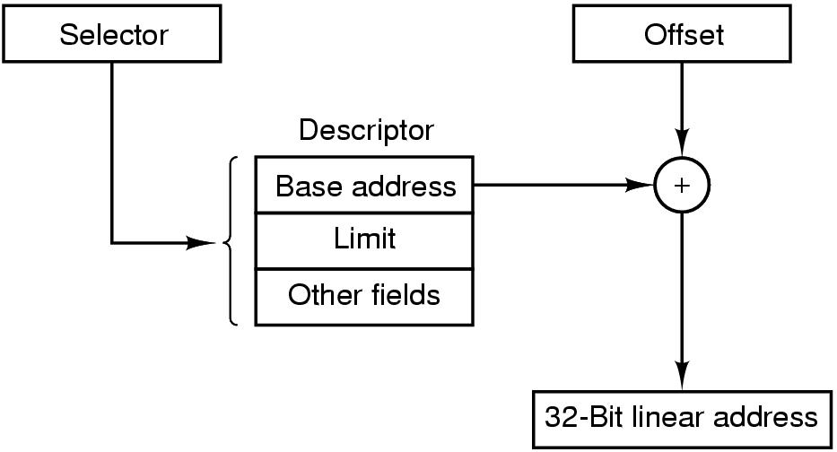
Segmentation with Paging: The Pentium
Address in the form of (Selector, offset) pair
(selector, offset) pair => selector is used to look up the segment descriptor
Base address from the descriptor is added to the offset => linear address
If paging is disabled, linear address is physical address
Otherwise, linear address is interpreted as virtual address, and needs to be converted.
Conversion shown in the next page.
Conversion of a (selector, offset) pair to a linear address.

Slide 54
Segmentation with Paging: The Pentium
Mapping of a virtual linear address onto a physical address.
What is a program does not need segmentation?
Set all segment register with the same selector, base=0, limit=maximum
Leads to just one address space

Slide 55
OPERATING SYSTEMS CSE 4300
Instructor:Mohammad Maifi Hasan Khan
Chapter 4 File Systems

Slide 56
File Systems (1)
Essential requirements for long-term information storage:
It must be possible to store a very large amount of information.
The information must survive the termination of the process using it.
Multiple processes must be able to access the information concurrently.

Slide 57
File Systems (2)
Think of a disk as a linear sequence of fixed-size blocks and supporting reading and writing of blocks. Questions that quickly arise:
How do you find information?
How do you keep one user from reading another’s data?
How do you know which blocks are free?

Slide 58
File Systems
File Naming
File Types
Regular , Directories, Character special, block special
File Access
Sequential, Random
File Attributes
Protection, Hidden flag, …

Slide 59
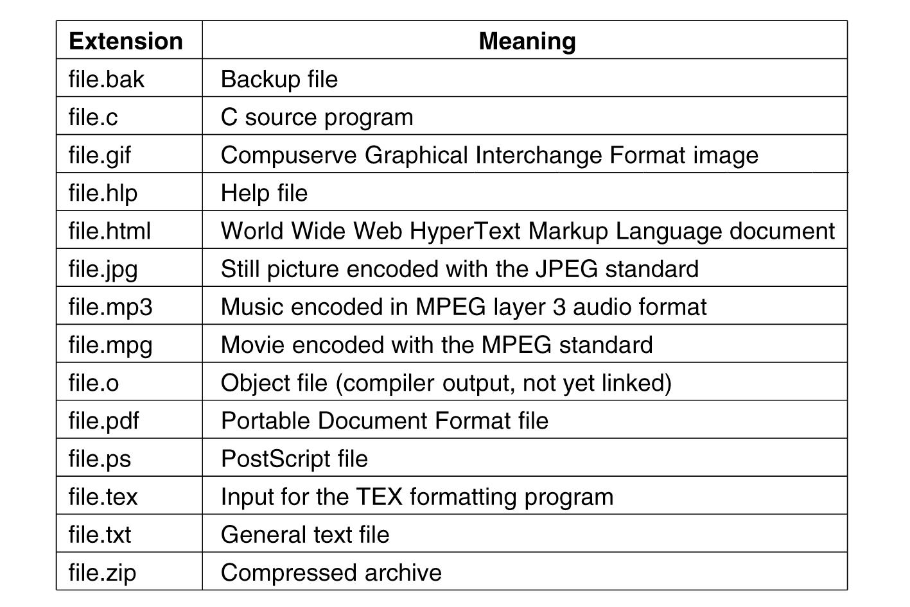
File Naming
Some typical file extensions.

Slide 60
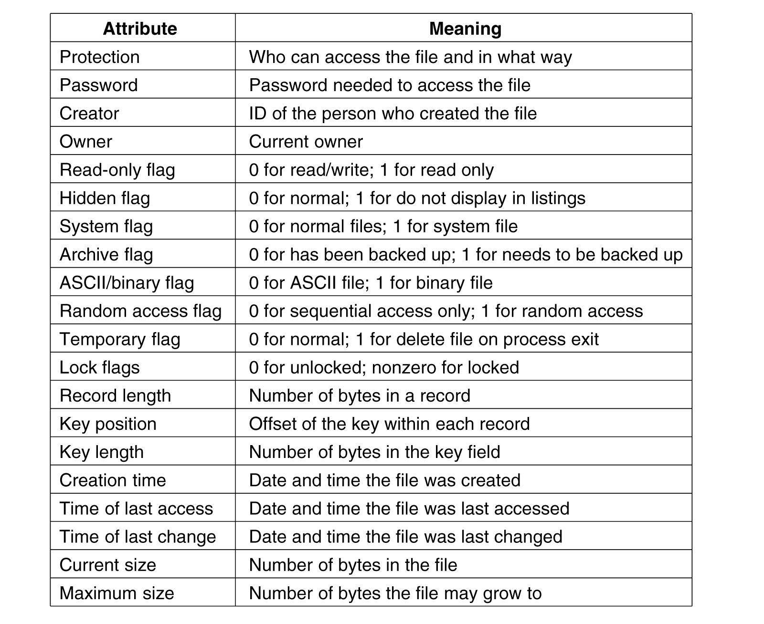
File Attributes
Some possible file attributes.

Slide 61
File Operations
The most common system calls relating to files:
Create
Delete
Open
Close
Read
Write
Append
Seek
Get Attributes
Set Attributes
Rename

Slide 62
Directories
Single-level directory
Hierarchical directory
Path names

Slide 63
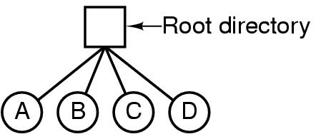
Hierarchical Directory Systems (1)
A single-level directory system containing four files.

Slide 64
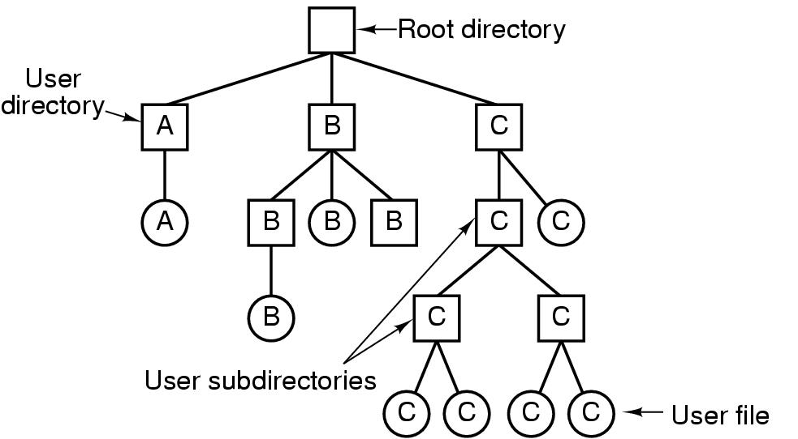
Hierarchical Directory Systems (2)
A hierarchical directory system.

Slide 65
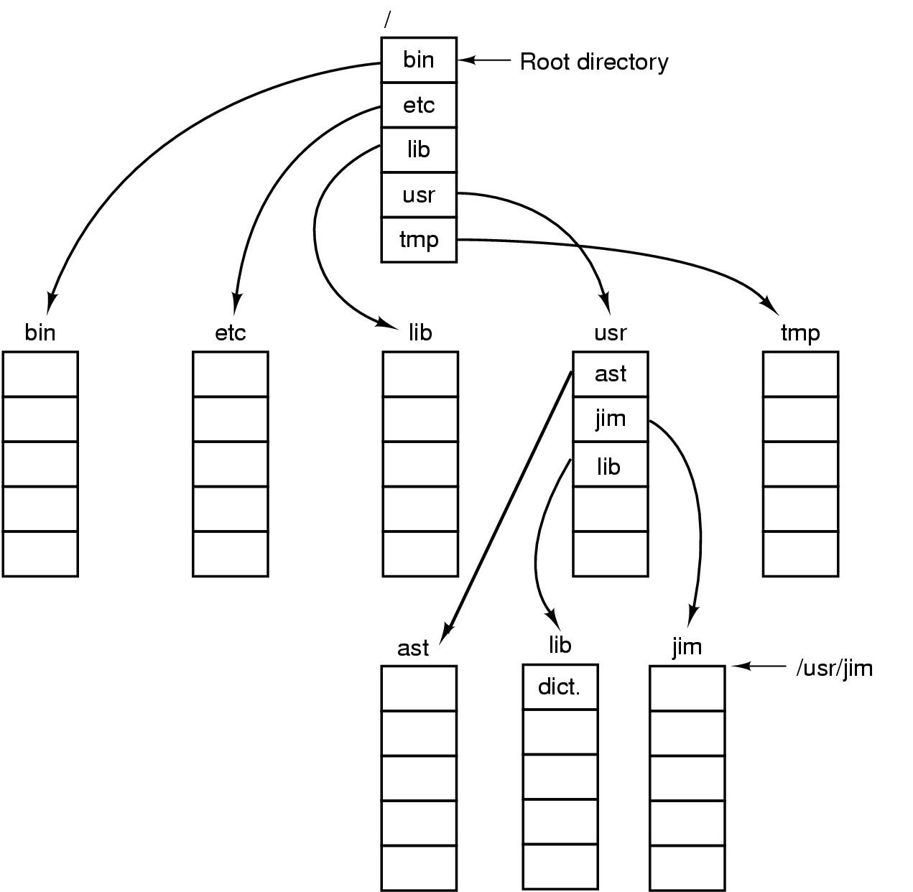
Path Names
A UNIX directory tree.

Slide 66
So Far, User’s view!
Now, how do we implement all these?

Slide 69
File System Layout
MBR – Sector 0
End of MBR contains the partition table
Each partition has independent file system
One partition is marked “Active”
BIOS first execute MBR
MBR program reads first block from active partition, which loads OS
A possible file system layout.

Slide 70
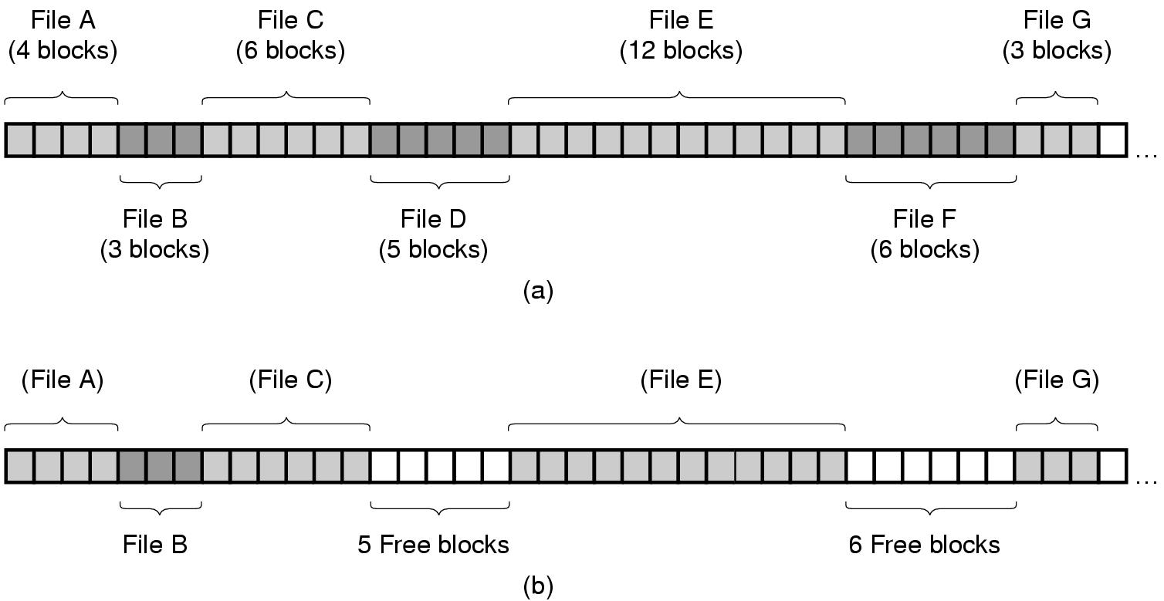
Contiguous Allocation
(a) Contiguous allocation of disk space for 7 files.
(b) The state of the disk after files D and F have been removed.

Slide 71
Contiguous Allocation
Advantages:
Simple to implement
Start disk block and length
Efficient to read back
Disadvantages
Fragmentation
Contiguous allocation is good for CD-Rom!

Slide 72
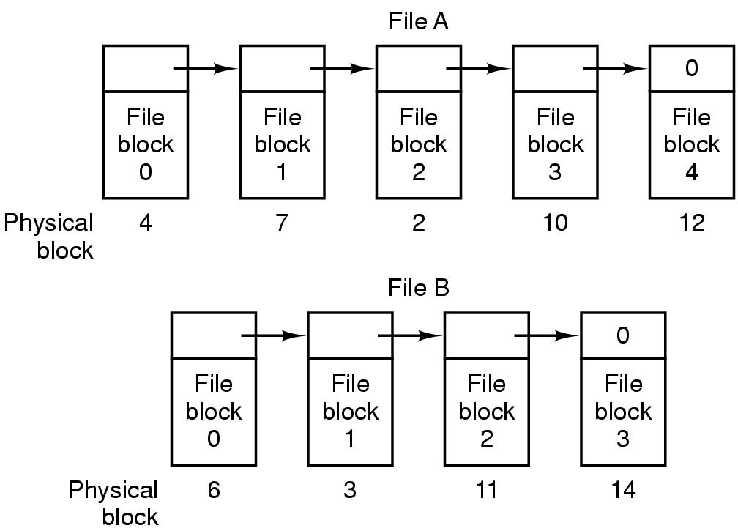
Linked List Allocation
Storing a file as a linked list of disk blocks.

Slide 73
Linked-list Allocation
Advantages:
No space lost due to disk fragmentation (still has internal fragmentation, space lost in the last block!)
Sequential access is straight-forward
Disadvantages
Random access slow
Not a power of 2 any more. May require to read two blocks and merge them manually

Slide 74
Linked List Allocation Using a Table
FAT: Not good for large disk!
For 2 GB disk and 1 KB block size, table needs 200 million entries!
Linked list allocation using a file allocation table

Slide 75
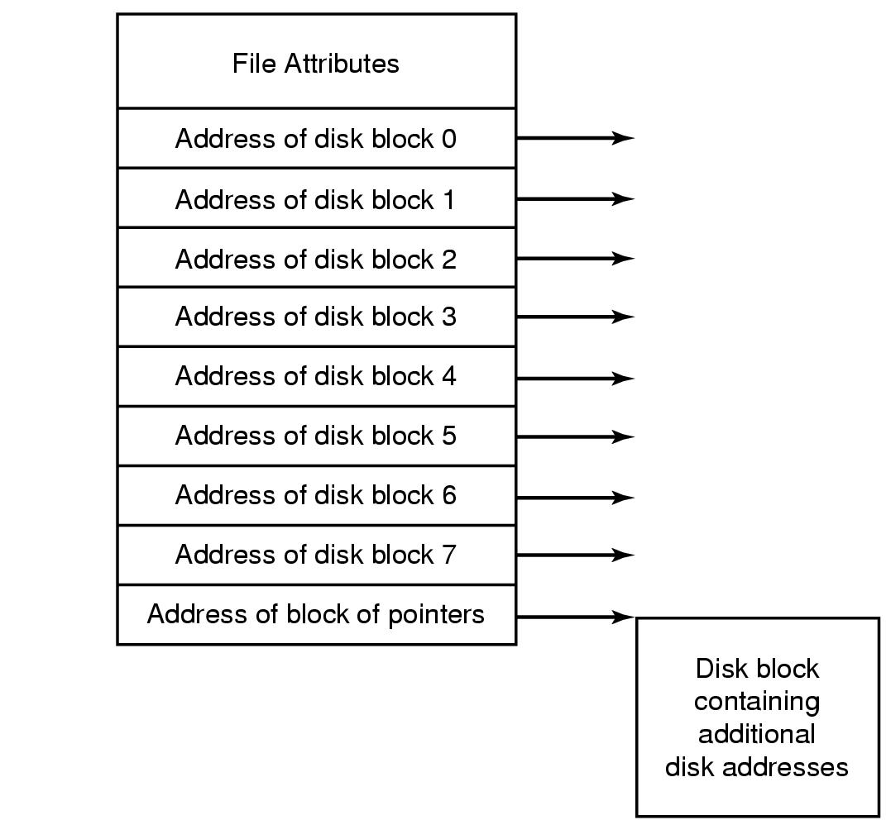
I-nodes
I-node per file:
Needs to be in memory only when the file is open
Size required is proportional to the maximum
number of files that can be open at the same time
I-node structure is fixed. So, what happens when the
file grows?
An example i-node.

Slide 76
I-nodes
I-node per file:
Needs to be in memory only when the file is open
Size required is proportional to the maximum
number of files that can be open at the same time
I-node structure is fixed. So, what happens when the
file grows?
An example i-node.

Slide 77
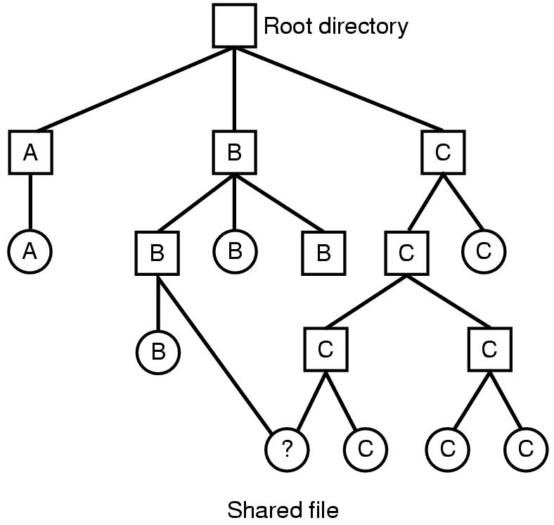
Shared Files (1)
Symbolic Link?
Hard Link?
Restoring from back up?
Link.
Linking allows a file to appear in more than one directory.
Linking that increase the counter in the file’s i-node is called a hard link.
Symbolic link
Instead of having two names point to the same internal data structure representing a file, a name is created that points to a file that includes the name of another file.
Symbolic link can allow to point to files across computers.
File system containing a shared file.

Slide 78
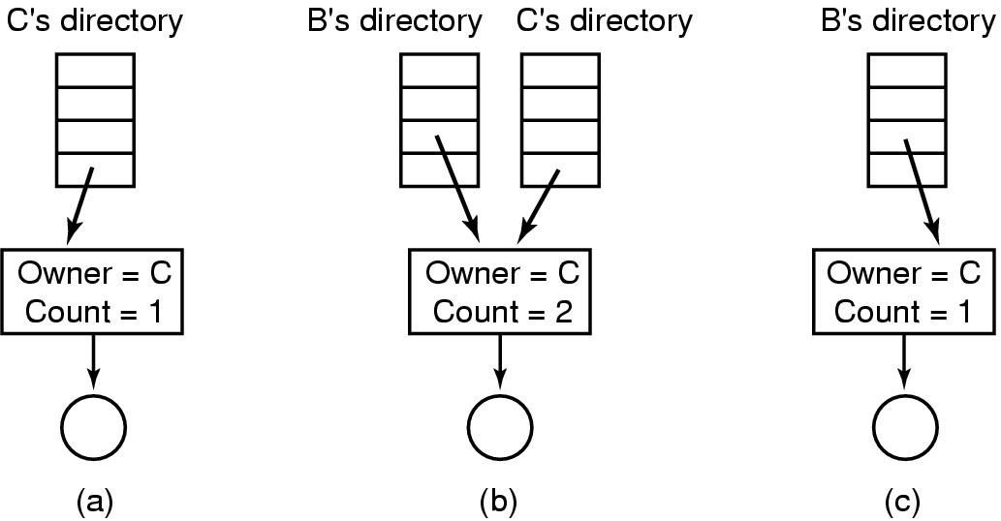
Shared Files (2)
(a) Situation prior to linking. (b) After the link is created. (c) After the original owner removes the file.

Slide 79
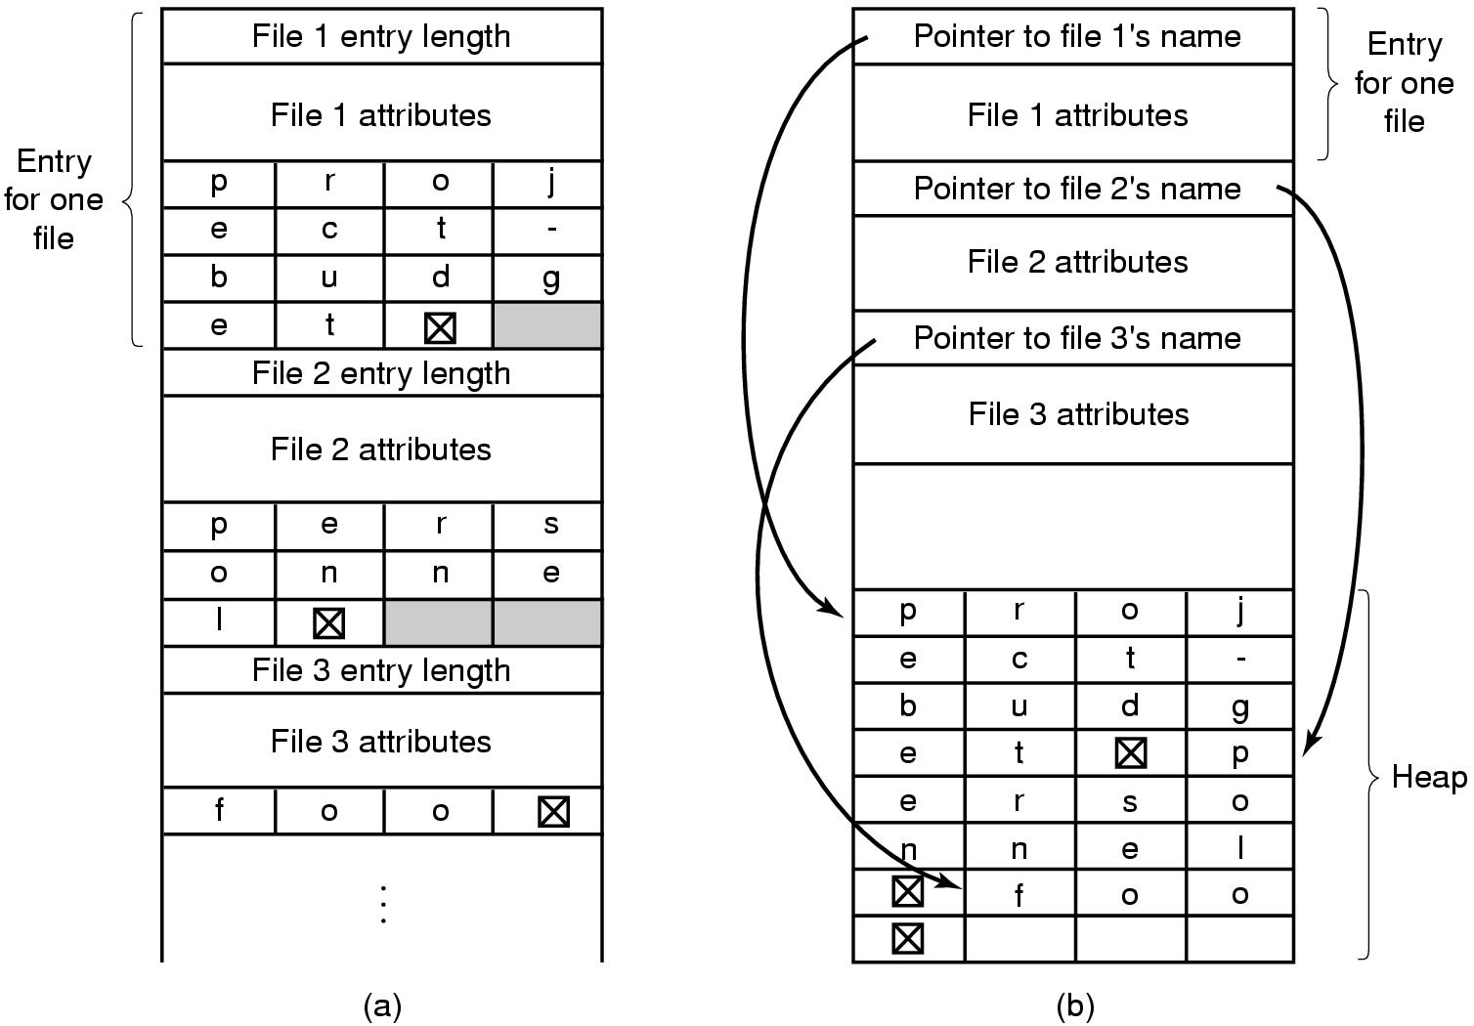
Implementing Directories (2)
Can page fault happen
due to long names?
Two ways of handling long file names in a directory. (a) In-line. (b) In a heap.

Slide 80
Implementing Directories - Challenges
How to efficiently look-up directory names?
Hashing
Hash on file names

Slide 81
Consider a disk with 1 MB per track.
Rotation time of 8.33 msec,
Avg. seek time 5 msec
How long it takes to read a block of k bytes?

Slide 83
Consider a disk with 1 MB per track.
Rotation time of 8.33 msec,
Avg. seek time 5 msec
How long it takes to read a block of k bytes?
5 + 8.33/2 + (k/1024*1024)*8.33
The book uses 1000000 to approximate 1024*1024

Slide 84
Disk Space Management Block Size
Percentage of files smaller than a given size
(in bytes).

Slide 86
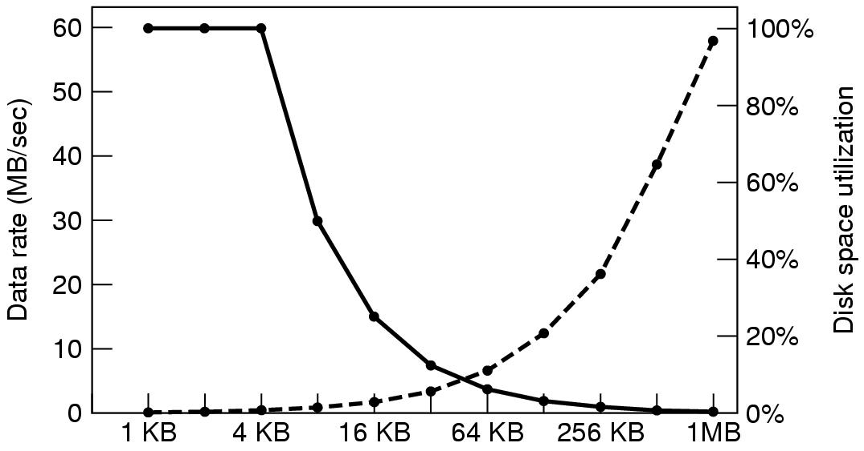
Disk Space Management Block Size (2)
The dashed curve (left-hand scale) gives the data rate of a disk. The solid curve (right-hand scale) gives the disk space efficiency. All files are 4 KB.

Slide 88
Keeping Track of Free Blocks (1)
(a) Storing the free list on a linked list. (b) A bitmap.

Slide 89
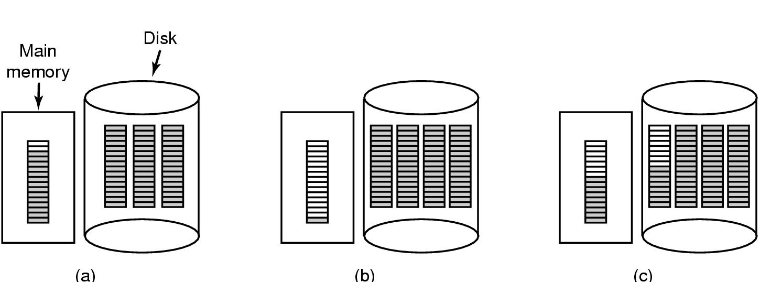
Keeping Track of Free Blocks (2)
(a) An almost-full block of pointers to free disk blocks in memory and three blocks of pointers on disk. (b) Result of freeing a three-block file. (c) An alternative strategy for handling the three free blocks. The shaded entries represent pointers to free disk blocks.

Slide 90
File System Backups (1)
Backups to tape are generally made to handle
Recovery from disaster.
Physical Dump: Dumps everything starting from block 0
Advantage:
Simplicity, great speed
Disadvantage
Inability to skip directories
Inability to make incremental dump
Inability to restore individual files

Slide 91
File System Backups (1)
No value in dumping unused block
Skipping free blocks require to store the block number along with dumped block
What about Bad block?
If disk controller handles transparently, no problem
If maintained by OS, dumping algorithm needs access to that info
Can not restore individual file!
Can not do incremental dump!

Slide 92
Logical Dump

Slide 93
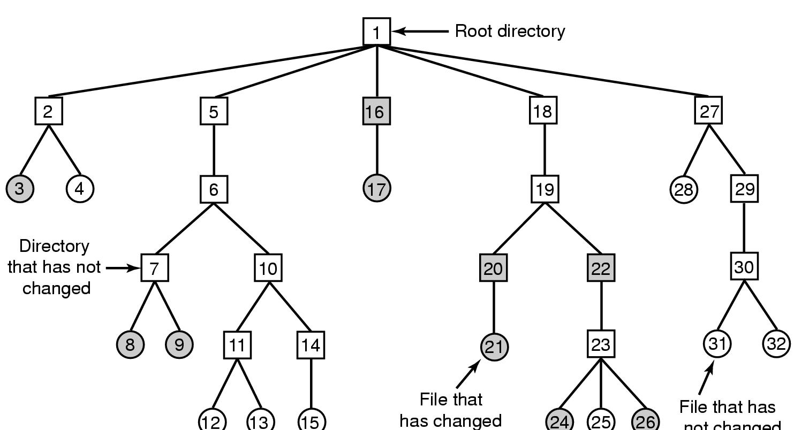
File System Backups (2)
A file system to be dumped. Squares are directories, circles are files. Shaded items have been modified since last dump. Each directory and file is labeled by its i-node number.

Slide 94
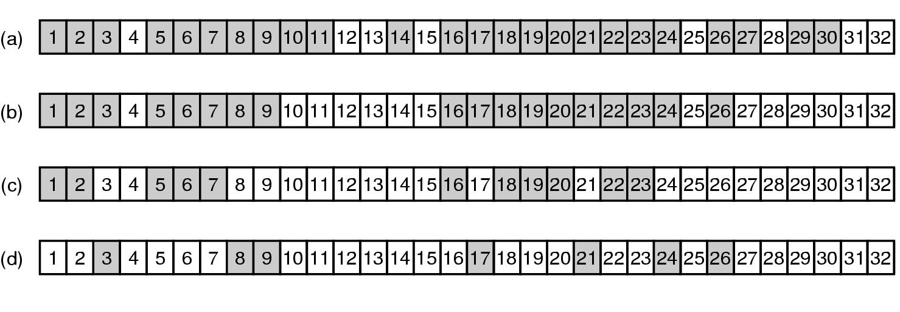
File System Backups (3)
Phase 1: First, start from root directory, Mark all the directories
and modified file in the bitmap
Phase 2: Unmark all directories that has no modified files under it
Phase 3: Dump the remaining directories
Phase 4: Dump the modified files
Bitmaps used by the logical dumping algorithm.

Slide 95
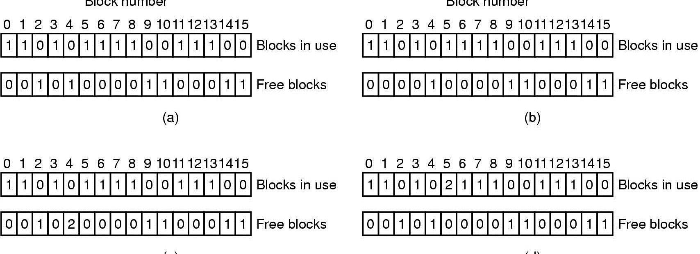
File System Consistency
File system states. (a) Consistent. (b) Missing block. (c) Duplicate block in free list. (d) Duplicate data block.

Slide 96
File System Performance Issues

Slide 97
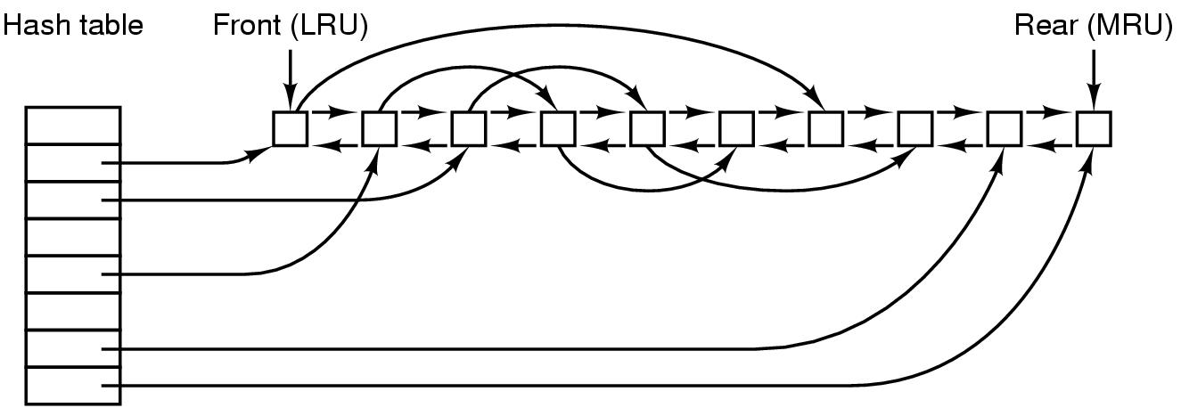
Caching
Hash calculated based on the device and disk address.
The buffer cache data structures.

Slide 98
Caching (2)
Original LRU algorithm is problematic
Some blocks, such as i-node blocks, are rarely referenced two times within a short interval.
Can leave some block in cache for a long time, increasing the risk of file system inconsistency in case of a system crash
Consider a modified LRU scheme, taking two factors into account:
Is the block likely to be needed again soon?
If no, put them at the beginning of the list
Is the block essential to the consistency of the file system?
If yes, write to disk immediately
Risk of keeping data in cache for too long
Write through Cache (Windows system)
Write any modified block immediately to disk
Sync (Linux)/Flushfilebuffers (Windows)

Slide 99
Block Read Ahead
Most files are read sequentially
Can we read ahead?
Keep a bit to keep track of the access pattern
Sequential vs random access

Slide 100
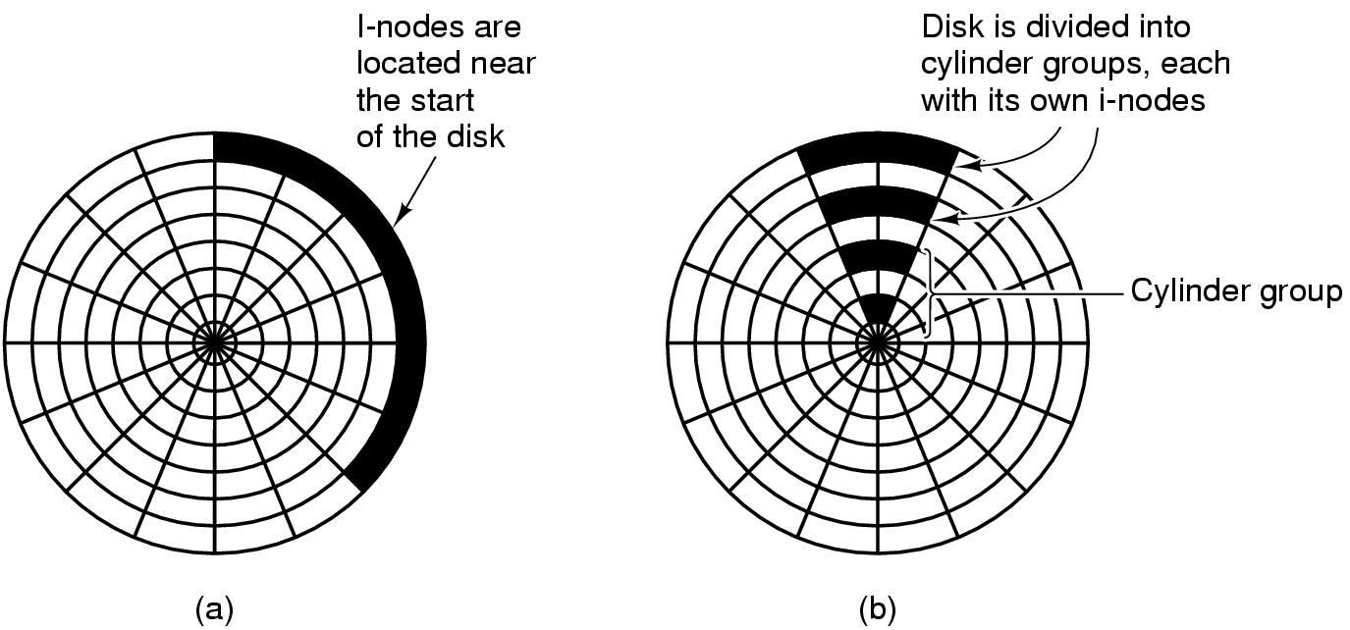
Reducing Disk Arm Motion
Not useful for SSD. Why?
(a) I-nodes placed at the start of the disk. (b) Disk divided into cylinder groups, each with its own blocks and i-nodes.

Slide 101
Defragmentation
Over time, disk usage becomes scattered
Defragmentation
Moves around files

Slide 102
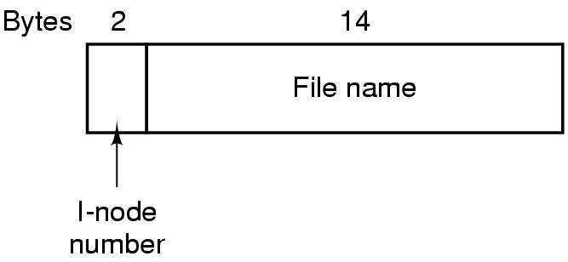
The UNIX V7 File System (1)
A UNIX V7 directory entry.

Slide 103
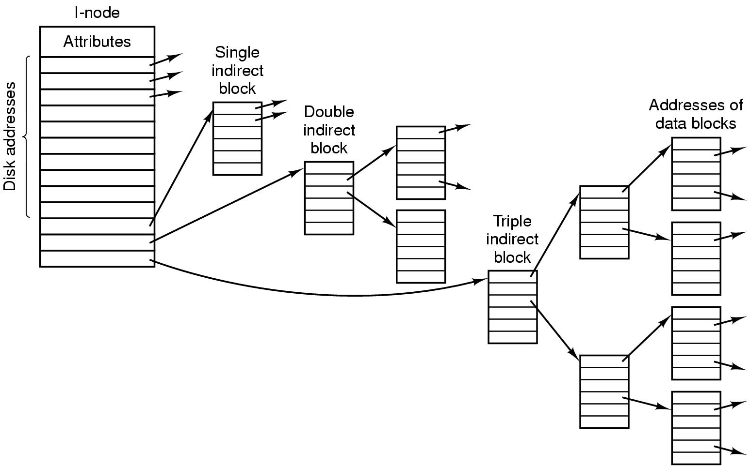
The UNIX V7 File System (2)
A UNIX i-node.

Slide 104
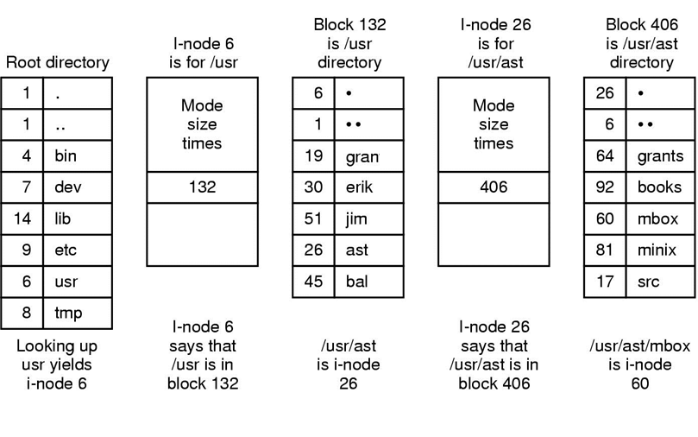
The UNIX V7 File System (3)
The steps in looking up /usr/ast/mbox.

Slide 105
Log Structured File system
Key observation
Most disk accesses are writes, read-ahead does not gain performance
Writes are done in small chunks
The Main idea is to structure the file system as a log
All the pending writes are buffered in memory and written to the disk at the end of the log as a segment
A segment may contain i-nodes, directory blocks, and data blocks
At the beginning of the segment, there is a summary
An i-node map is maintained indexed by i-number. Entry i in the map points to i-node i on the disk
If a file is overwritten, its i-node now points to the new segment
Disk is treated as a circular log
Cleaner thread takes care of fragmentation

Slide 106
Log Structured File system
If a file is overwritten, its i-node now points to the new segment.
Old segment still occupies space!!
Disk is treated as a circular buffer
Cleaner thread takes care of fragmentation by moving valid old segments to the front of the log and removing old ones from the back

Slide 107
Journaling File system
Removing a file
Remove the file from its directory
Release the i-node to the pool of free i-nodes
Return all the disk blocks to the pool of free disk blocks
Log all the operations in a file before actually performing them
All logged operation must be idempotent

Slide 108
OPERATING SYSTEMS CSE 4300 Instructor: Mohammad Maifi Hasan Khan Chapter 6 Deadlocks

Slide 109
Preemptable and Nonpreemptable Resources
Sequence of events required to use a resource:
Request the resource.
Use the resource.
Release the resource.

Slide 110
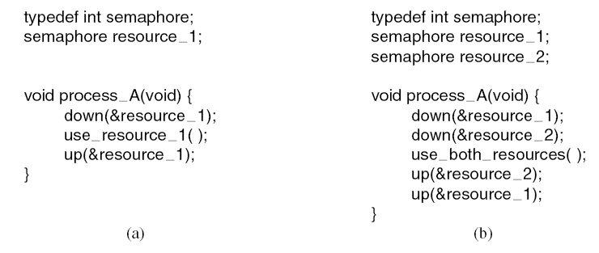
Resource Acquisition (1)
Using a semaphore to protect resources. (a) One resource. (b) Two resources.

Slide 111
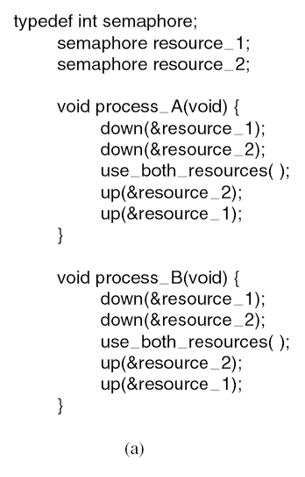
Resource Acquisition (2)
Deadlock-free code.

Slide 112
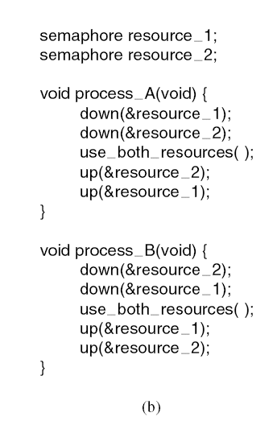
Resource Acquisition (3)
Code with a potential deadlock.

Slide 113
Introduction To Deadlocks
Deadlock can be defined formally as follows:
A set of processes is deadlocked if each process in the set is waiting for an event that only another process in the set can cause.

Slide 114
Conditions for Resource Deadlocks
Mutual exclusion condition: Each resource is either currently assigned to exactly one process or is available
Hold and wait condition: Processes can request new resources
No preemption condition: Process must explicitly release resources
Circular wait condition: Must be a circular chain of wait

Slide 115
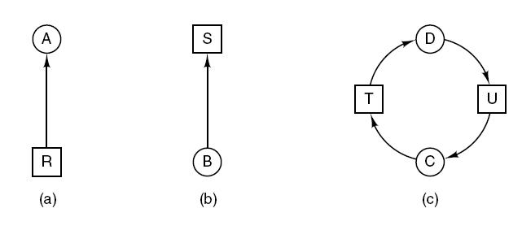
Deadlock Modeling (1)
Process: Circles
Resource: Squares
R is held by A
B is waiting for S
Resource allocation graphs. (a) Holding a resource. (b) Requesting a resource. (c) Deadlock.

Slide 116
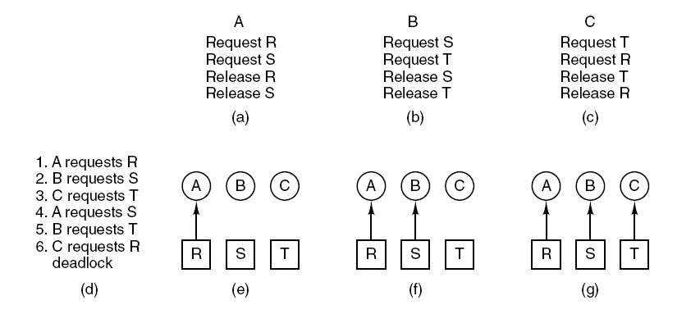
Deadlock Modeling (2)
An example of how deadlock occurs and how it can be avoided.

Slide 117
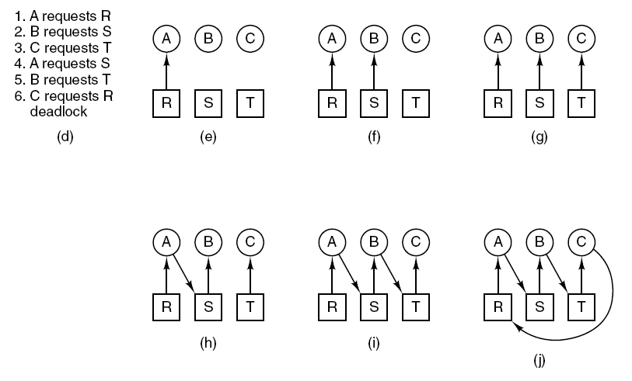
Deadlock Modeling (3)
An example of how deadlock occurs and how it can be avoided.

Slide 118
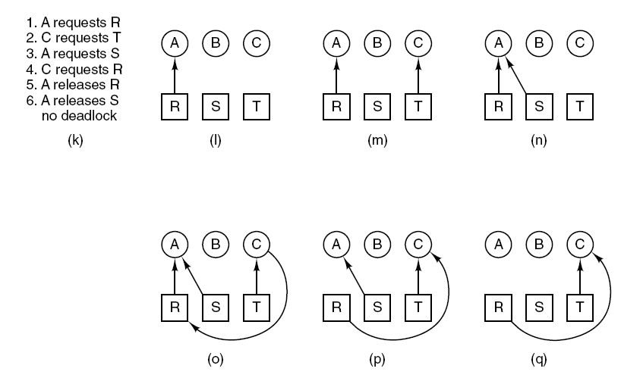
Deadlock Modeling (4)
An example of how deadlock occurs and how it can be avoided.

Slide 119
Deadlock Modeling (5)
Strategies for dealing with deadlocks:
Just ignore the problem.
Detection and recovery. Let deadlocks occur, detect them, take action.
Dynamic avoidance by careful resource allocation.
Prevention, by structurally negating one of the four required conditions.

Slide 120
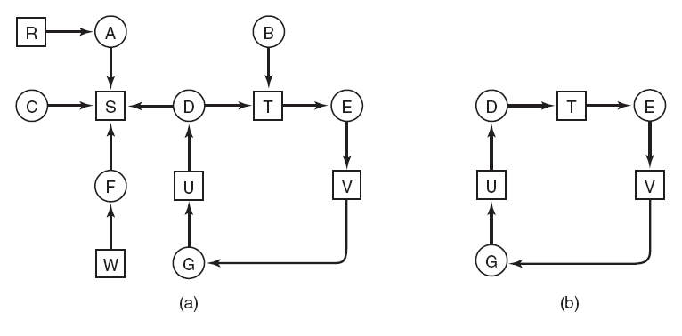
Deadlock Detection with One Resource of Each Type (1)
(a) A resource graph. (b) A cycle extracted from (a).

Slide 121
Deadlock Detection with One Resource of Each Type (2)
Algorithm for detecting deadlock:
For each node, N in the graph, perform the following five steps with N as the starting node.
Initialize L to the empty list, designate all arcs as unmarked.
Add current node to end of L, check to see if node now appears in L two times. If it does, graph contains a cycle (listed in L), algorithm terminates. …

Slide 122
Deadlock Detection with One Resource of Each Type (3)
From given node, see if any unmarked outgoing arcs. If so, go to step 5; if not, go to step 6.
Pick an unmarked outgoing arc at random and mark it. Then follow it to the new current node and go to step 3.
If this is initial node, graph does not contain any cycles, algorithm terminates. Otherwise, dead end. Remove it, go back to previous node, make that one current node, go to step 3.

Slide 123
Try the Algorithm on this one ☺
(a) A resource graph. (b) A cycle extracted from (a).

Slide 124
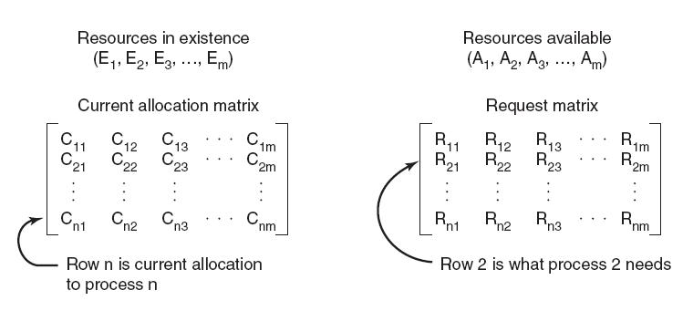
Deadlock Detection with Multiple Resources of Each Type (1)
The four data structures needed by the deadlock detection algorithm.

Slide 125
Deadlock Detection with Multiple Resources of Each Type (2)
Deadlock detection algorithm:
Look for an unmarked process, P_{i} , for which the i-th row of R is less than or equal to A.
If such a process is found, add the i-th row of C to A, mark the process, and go back to step 1.
If no such process exists, the algorithm terminates.

Slide 126
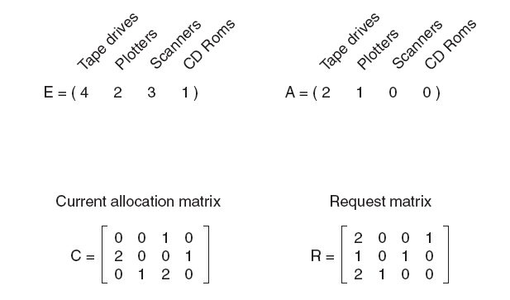
Deadlock Detection with Multiple Resources of Each Type (3)
An example for the deadlock detection algorithm.

Slide 127
Recovery from Deadlock
Recovery through preemption
Manually pause a print job and take away a printer
Recovery through rollback
Use “Checkpointing” to roll back a process to a time before it acquired the resource that can break the deadlock, pause, and restart later
Recovery through killing processes
Keep killing processes until the deadlock is broken.
You may kill a process which is not involved in the deadlock

Slide 128
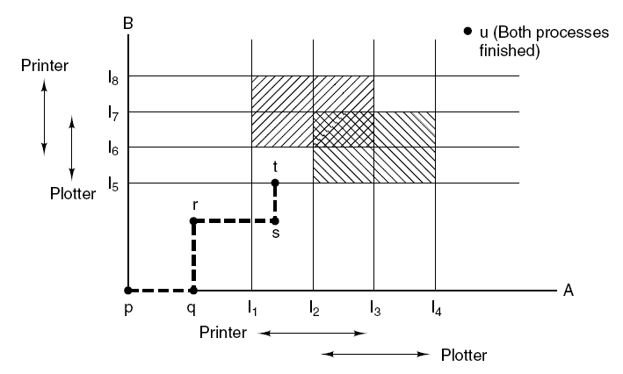
Deadlock Avoidance
Two process resource trajectories.

Slide 129

Safe and Unsafe States (1)
Demonstration that the state in (a) is safe.

Slide 130

Safe and Unsafe States (2)
Demonstration that the state in (b) is not safe.

Slide 131

The Banker’s Algorithm for a Single Resource
Three resource allocation states: (a) Safe. (b) Safe. (c) Unsafe.

Slide 132

The Banker’s Algorithm for Multiple Resources (1)
The banker’s algorithm with multiple resources.

Slide 133
The Banker’s Algorithm for Multiple Resources (2)
Algorithm for checking to see if a state is safe:
Look for row, R, whose unmet resource needs all ≤ A. If no such row exists, system will eventually deadlock since no process can run to completion
Assume process of row chosen requests all resources it needs and finishes. Mark process as terminated, add all its resources to the A vector.
Repeat steps 1 and 2 until either all processes marked terminated (initial state was safe) or no process left whose resource needs can be met (there is a deadlock).

Slide 134
Deadlock Prevention
Attacking the mutual exclusion condition
No resources ever assigned exclusively to a single process
Not practical
Attacking the hold and wait condition
Request all resources at the beginning
Need to know a priori
Non-optimal use of resources
Attacking the no preemption condition
Virtualize resources (e.g., printer daemon)
Attacking the circular wait condition

Slide 135

Attacking the Circular Wait Condition
(a) Numerically ordered resources. (b) A resource graph.

Slide 136
Other Issues
Two-phase locking
Database systems
Lock all the records before starts making changes. If all records not available, release and restart.
Not practical for real-time systems
Communication deadlocks
Request message gets lost
Timeout mechanism is used
Livelock (Not a deadlock)
All philosopher tries to acquire left fork, and then right fork
With small probability, they will keep trying
Starvation
What if a printer gives priority to small files?
Not a deadlock

